Slide 1
Swarm Robots:
MONA
Name: Muhammad Zulhafiz Bin Zulkifli
Matric No: 1812661

Slide 2
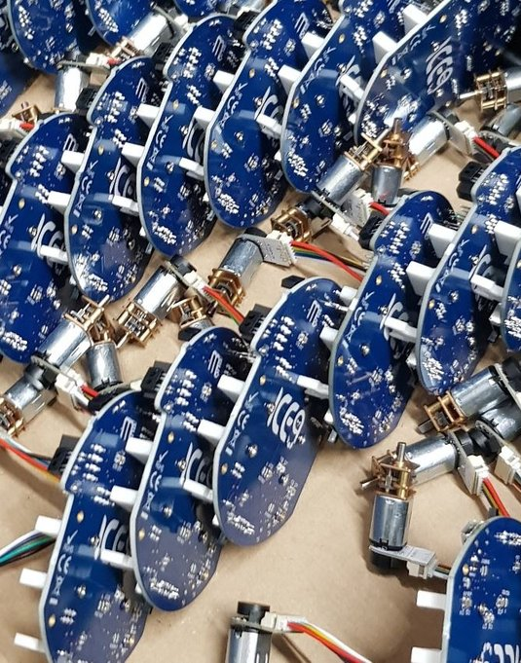
HISTORY
The MONA robotic platform is an open-hardware/open-source robotic platform that has been developed to be used in swarm robotics research, to understand research topics such as perpetual swarms, multi-agent interaction and human-interaction/control with a swarm of robotic platforms.
The MONA is a small, circular robot, 80mm in diameter, with 2 wheels controlled by brushed DC motors with in-built encoders as well as 5 x IR transmitter receivers along the front half of the robot. Based off the Arduino architecture, the MONAs can be programmed using the Arduino IDE, which has seen them used in undergraduate teaching labs to teach basic programming and circuit analysis techniques.
Much like Arduinos, the MONA is capable of carrying add-on boards to increase or adapt its functionality. Example add-ons are a wireless-charging board, a radio comms board, an IMU board, a Raspberry Pi Zero interface board, LDR board and a comms board adding wi-fi, Bluetooth and 360 degree IR communications. This comms board can also enable additional computing power to run ROS-serial, making it an attractive solution to any researchers using ROS to interact and control their robotic systems.

Slide 3
ROBOTICS HARDWARE COMPONENTS
Robot Design
Actuators & Locomotions
Navigation & Controller
Data Collection
Data Transmission
Power System Management

Slide 4
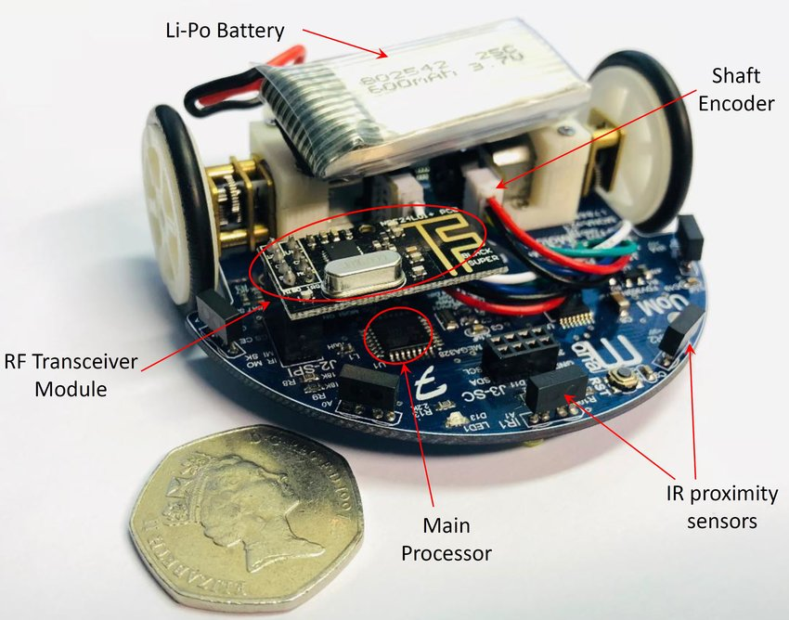
1 - Robot Design
Mona uses a circular PCB board with the diameter of 80 mm accommodates its modules including main processor, motors and drivers, IR proximity sensors, and power management.
Specifications list:
80mm in diameter
2 x DC motors
2 x Hall-effect encoders
5 x IR transmitter/receivers
I2C, SPI and UART comms available
4-8 hrs battery life

Slide 5
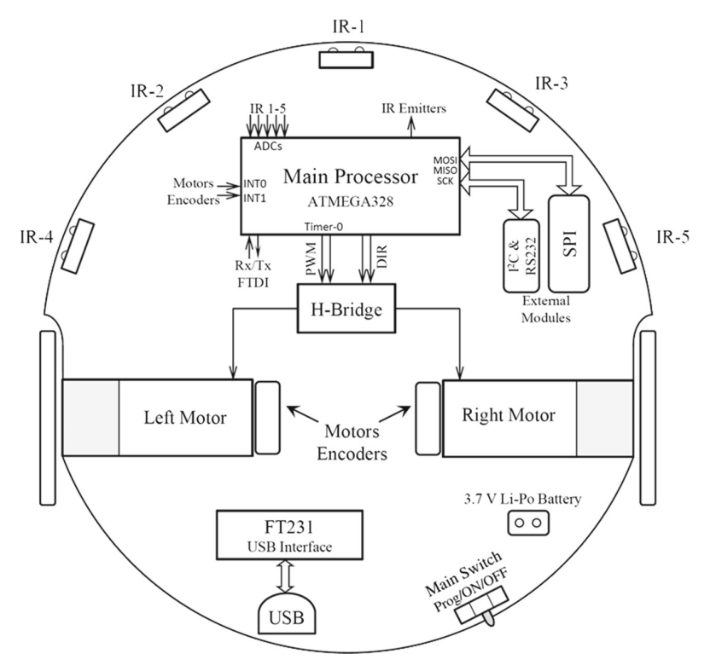
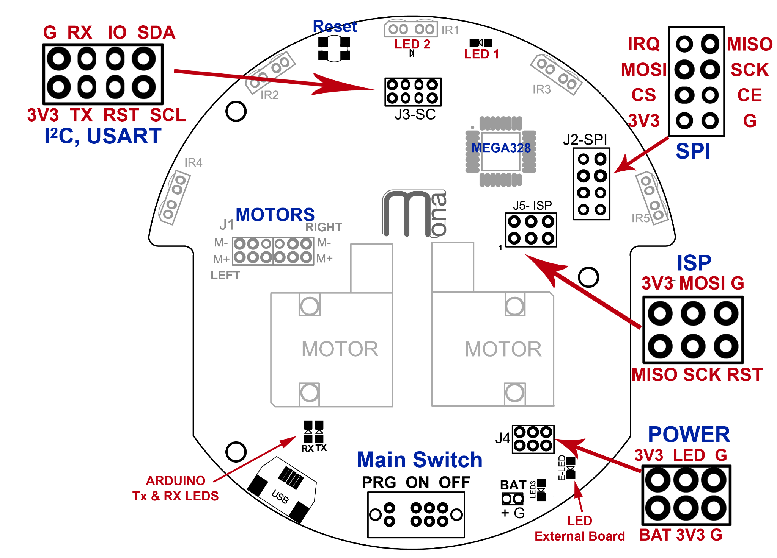
1 - Robot Design

Slide 6
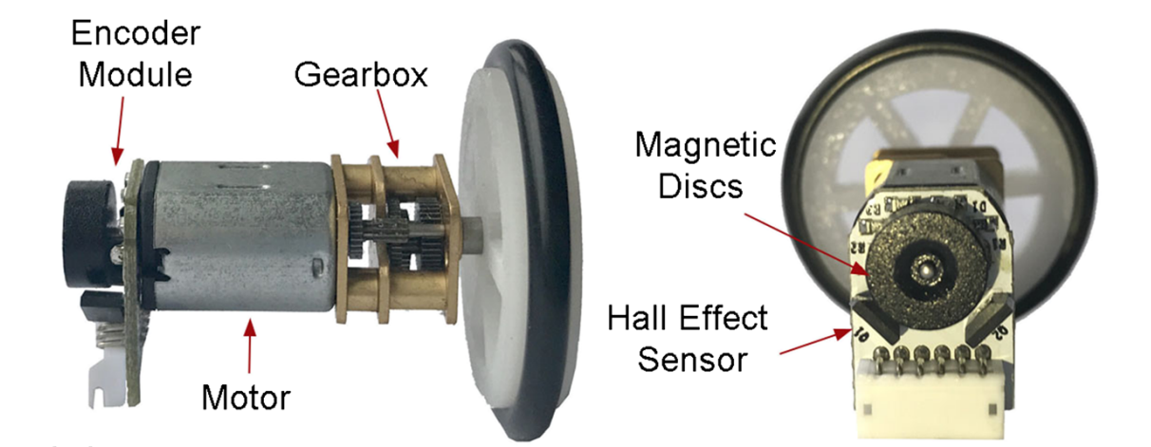
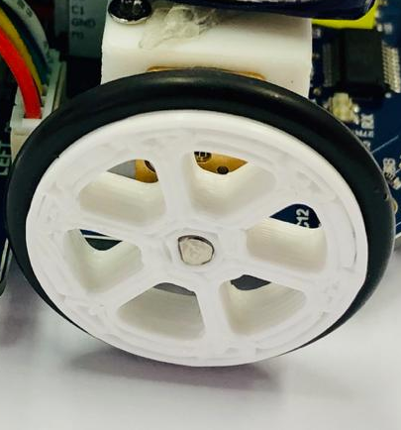
2 - Actuators & Locomotions
Micro DC gearhead motors
3D printed motor bracket & wheels

Slide 7
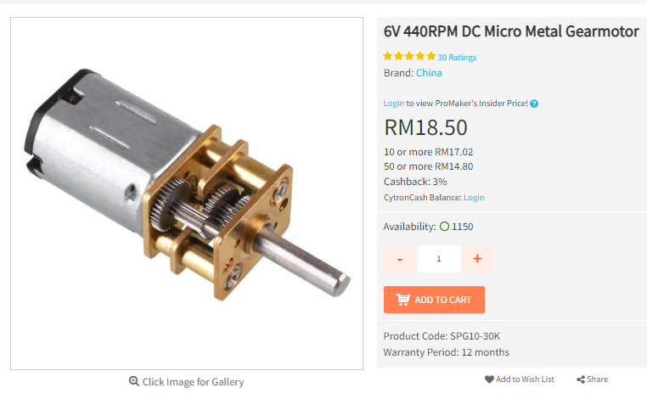
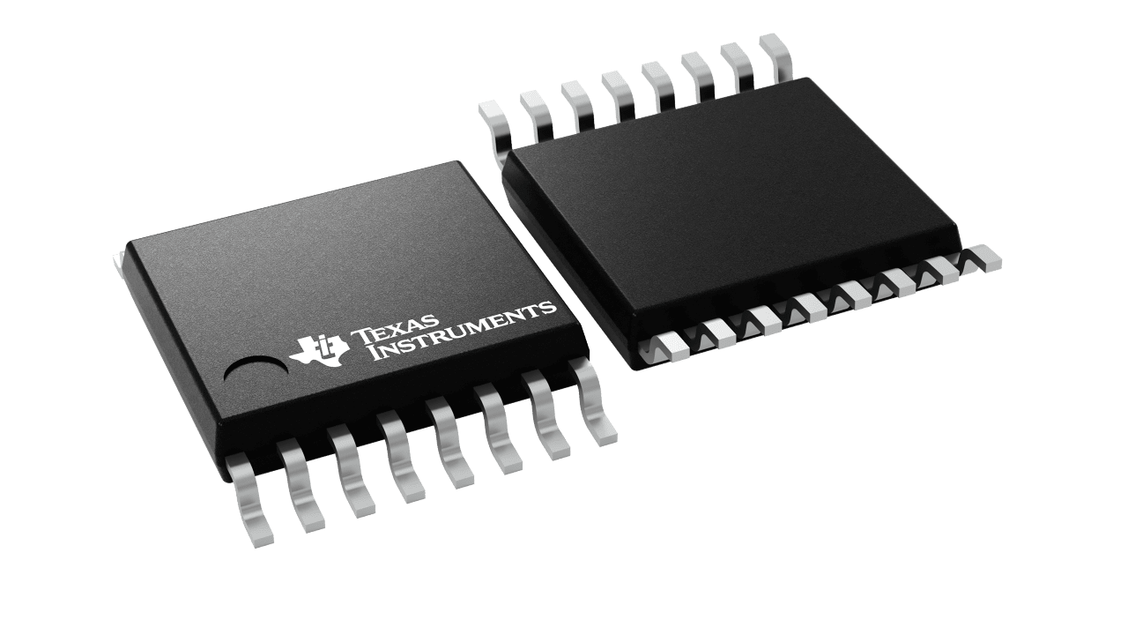
2 - Actuators & Locomotions
H-Bridge Motor Driver - TI DRV8833 https://www.ti.com/lit/gpn/drv8833

Slide 8
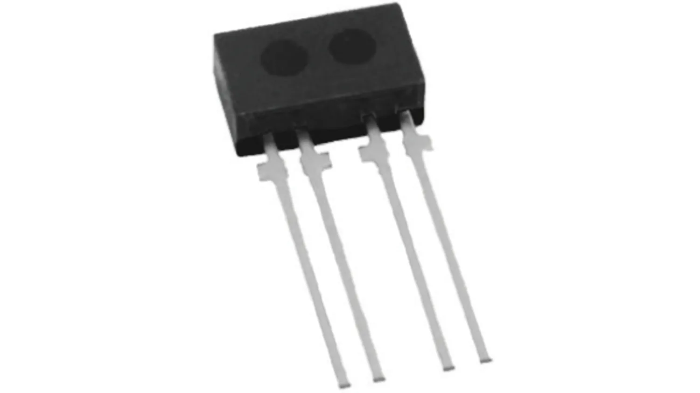
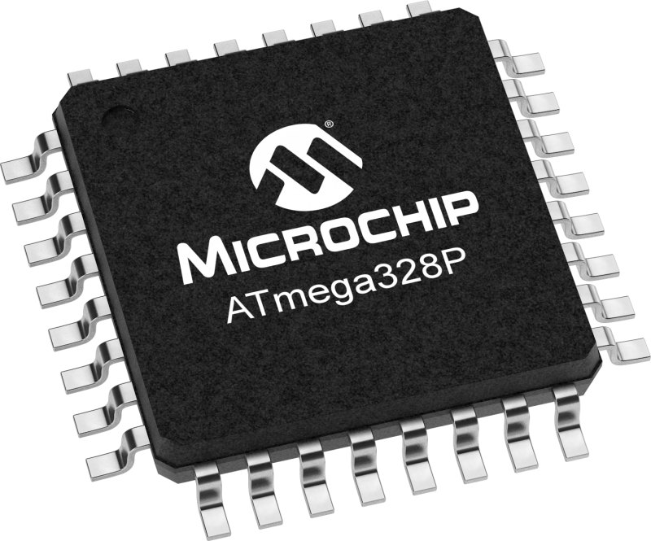
3 - Navigation & Controller
IR Proximity Sensor - Vishay TCRT1000 https://www.vishay.com/docs/83752/tcrt1000.pdf
Main Controller - AVR ATmega328p
https://www.microchip.com/en-us/product/ATmega328P
The main sensory system which is used in Mona is the short-range IR proximity sensors. Five sensors in front half of the robot, which were located in 35◦ angular distance estimate the distance of an obstacle.

Slide 9
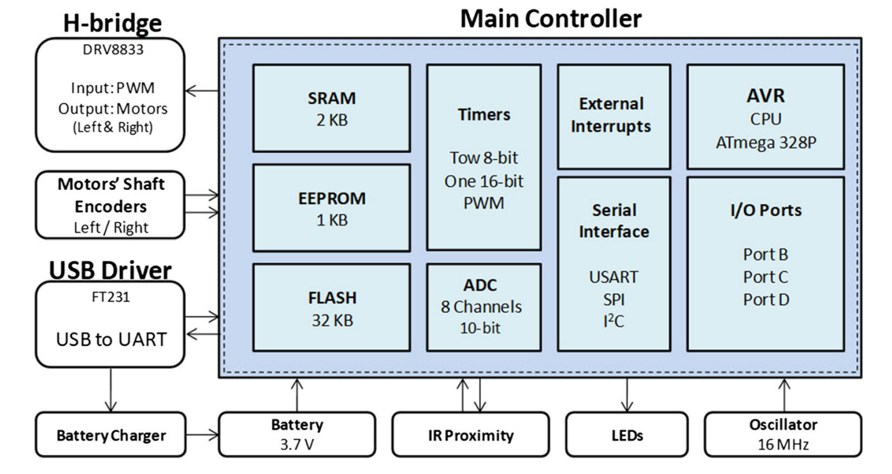
3 - Navigation & Controller

Slide 10
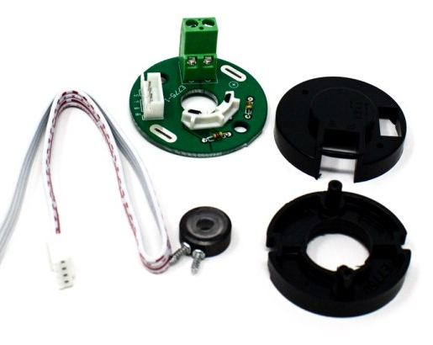
4 - Data Collection
2ppr Encoder- Magnetic Discs with Hall Effect Sensor
The output of the encoders can be used as an input to a proportional-integral-derivative (PID) controller for closed-loop motion control.

Slide 11
5 - Data Transmission
Mona supports three serial communication methods including:
– USART: used to send and receive data via USB (FTDI module). It is mainly for the Arduino programming link, but it can also be used to communicate with other add-on boards such as a Raspberry Pi or a bio-inspired vision system.
– I2C: is a general purpose communication link which can be used by external modules which support I2C protocol e.g. temperature sensor.
– SPI: is mainly used for RF communication module (e.g. NRF24L01 2.4 GHz). It is also used for programming of μC using the ISP method.

Slide 12
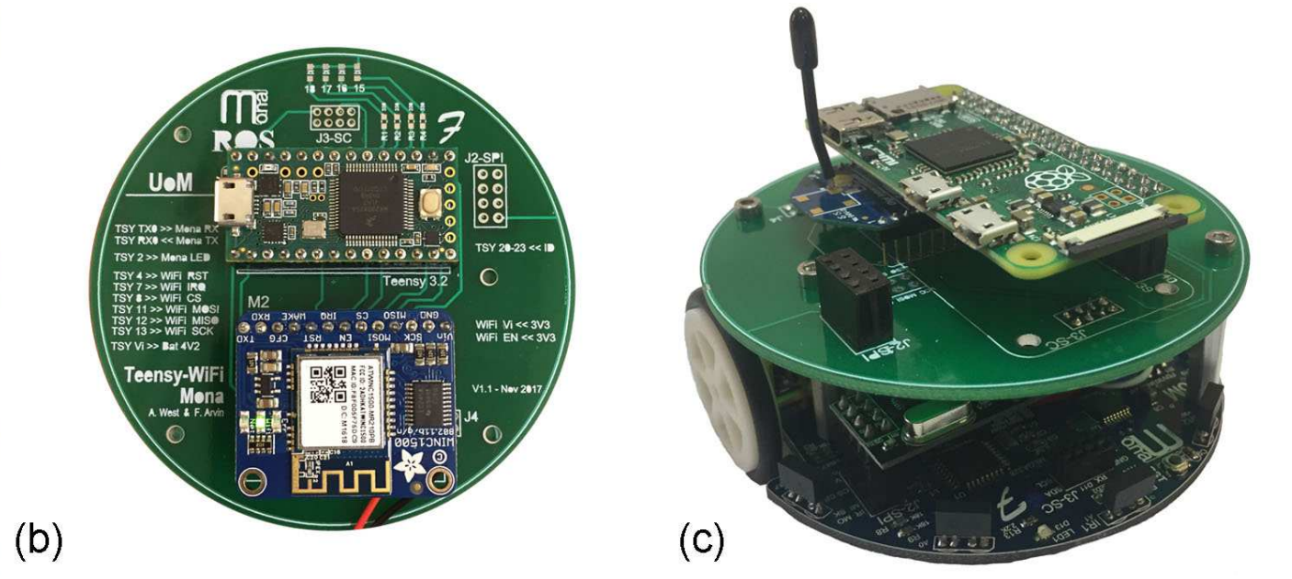
5 - Data Transmission
To study on possibility of controlling Mona using ROS (Robot Operating System), a breakout board has been made that supports a Teensy 3.2 module and a WiFi module. The board was attached on top of Mona and communicates via UART. In this configuration, an ID was assigned to each Mona and the base-station (ROS server) receives sensory readings from each Mona and also sends commands to Mona’s motors and LEDs via WiFi module.

Slide 13
5 - Data Transmission
In addition, a breakout board has been developed which supports:
i) Raspberry Pi Zero
ii) XBee module
iii) NRF24L01 RF transceiver
The board is mounted on top of the main platform and is able to communicate with the main platform using RS232 serial port.

Slide 14
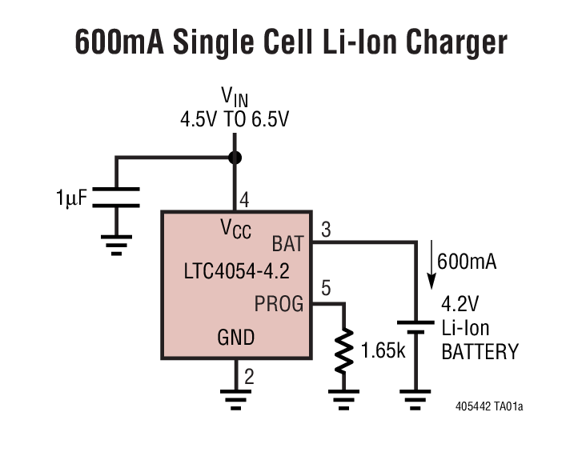
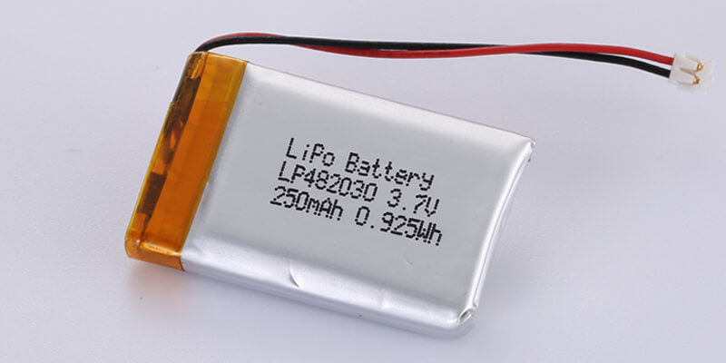
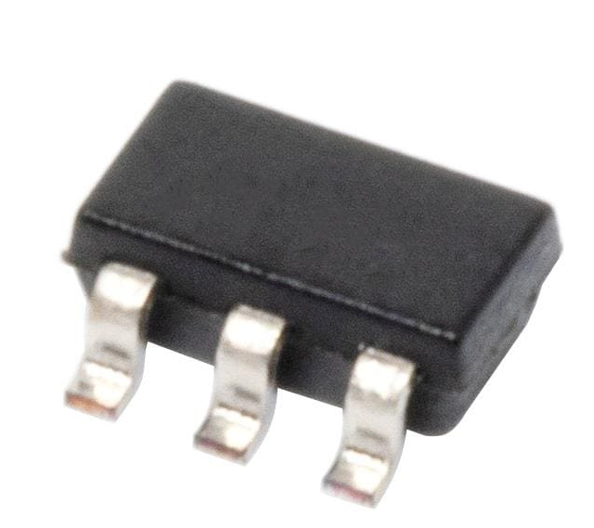
6 - Power System Management
3.7V 250mAh Rechargeable Li-Po Battery
https://www.li-polymer-battery.com/wp-content/uploads/2021/03/LP482030-250mAh-JST-ACHR-02V-S-B.pdf
Li-Ion Battery Charger - LTC4054-4.2 https://www.analog.com/media/en/technical-documentation/data-sheets/405442xf.pdf

Slide 15
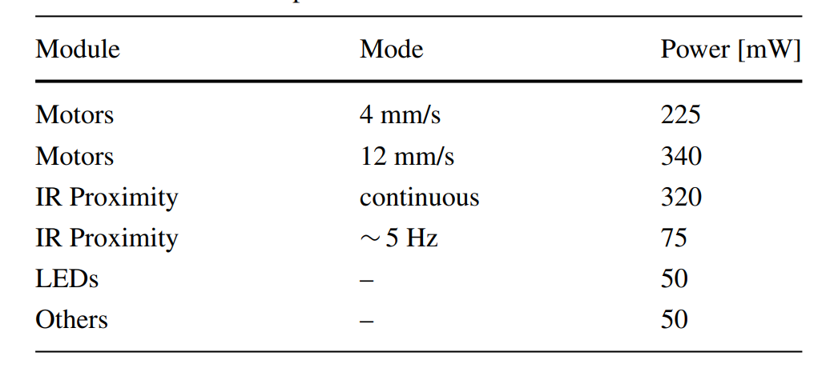
6 - Power System Management
Power Consumption

Slide 16
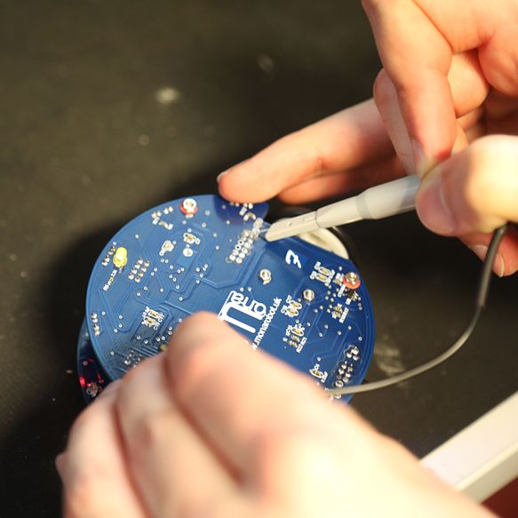
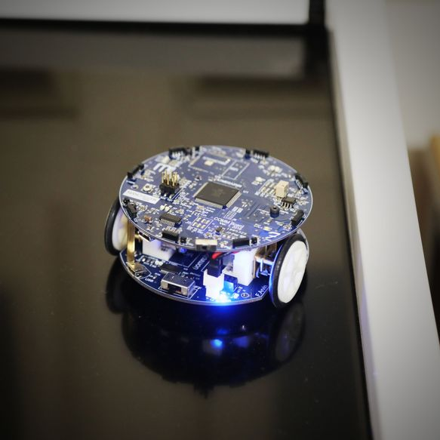

Slide 17
